Slide 1
An In-Depth Study of Correlated Failures in Production SSD-Based Data Centers
Shujie Han¹, Patrick P. C. Lee¹, Fan Xu², Yi Liu², Cheng He², and Jiongzhou Liu²
¹The Chinese University of Hong Kong
²Alibaba Group
Notes:
Hi, I am Shujie Han from The Chinese University of Hong Kong.
I am going to present the work “An in-depth study of correlated
failures in production SSD-based data centers”
This is a joint work with folks from Alibaba Group.

Slide 2
Motivation
Correlated failures
Challenge high storage reliability
Complicate design of redundancy protection schemes
Solid-state drives (SSDs) become the mainstream storage media in modern data centers
What are the characteristics of correlated failures of SSDs?
What are implications of correlated failures of SSDs on storage reliability in production environments?
Notes:
Correlated failures challenge high storage reliability
and complicate the design of redundancy protection schemes.
As SSDs become the mainstream storage media
in modern data centers, the storage reliability of data centers
critically depends on the reliability of SSDs.
However, little is known about the characteristics of
correlated failures of SSDs and their implications on
storage reliability in production environments.

Slide 3
Our Contribution
An in-depth data-driven analysis on correlated failures of SSDs from spatial and temporal perspectives
We provide 15 findings on correlated failures
Intra-node and intra-rack failures
Impact of drive characteristics, SMART attributes, and applications
Trace-driven simulation on reliability of redundancy schemes under correlated failures
We release our dataset and source code for public use
Notes:
In this work, we present an in-depth data-driven analysis
on correlated failures, from spatial and temporal perspectives,
of SSD-based data centers at Alibaba.
We provide 15 findings on correlated failures
including intra-node and intra-rack failures.
We analyze the impacting factors of drive characteristics,
SMART attributes, and applications on correlated failures.
We conduct trace-driven simulation on the storage reliability of
different redundancy protection schemes under correlated failures.
We release our dataset and source code for public use.

Slide 4
Dataset
Collect nearly 1 million SSDs of 11 drive models from 3 vendors over two-year span (Jan. 2018 – Dec. 2019) at Alibaba
Data types: SMART logs, trouble tickets, locations (e.g., nodes and racks), and applications
Two main types of SSD failures in trouble tickets:
Whole drive failures: an SSD either cannot be accessed or loses all data that is unrecoverable
Partial drive failure: part of the data in an SSD either cannot be accessed and is unrecoverable
Notes:
We collected nearly one million SSDs of 11 drive models
from 3 vendors over a two-year span
in multiple SSD-based data centers at Alibaba.
Our dataset includes multiple data types: SMART logs,
trouble tickets, locations (e.g., nodes and racks), and applications.
Our trouble tickets cover two main types of SSD failures:
Whole drive failures, in which an SSD either cannot be accessed
or loses all data that is unrecoverable
Partial drive failure, in which part of the data in an SSD either
cannot be accessed and is unrecoverable

Slide 5
Analysis Methodology
Spatial and temporal properties
Intra-node (intra-rack) failures: failures co-occurring within a node (rack)
Intra-node (intra-rack) failure time interval: 30 minutes by default
Intra-node (intra-rack) failure group: a sequence of intra-node (intra-rack) failures
Correlation properties
Spearman’s Rank Correlation Coefficient (SRCC)
Measure correlations between correlated failures and SMART attributes
Notes:
We study the correlated failures from the following dimensions:
Spatial and temporal properties
We study how SSD failures manifest
within a node or a rack by considering
intra-node and intra-rack failures to
refer to the failures co-occurring within a node (rack), respectively
We set a default threshold of intra-node and
intra-rack failure time interval as 30 minutes.
We define the intra-node (intra-rack) failure group
as a sequence of intra-node (intra-rack) failures
Correlation properties
We use the SRCC to measure the correlations
between correlated failures and SMART attributes

Slide 6
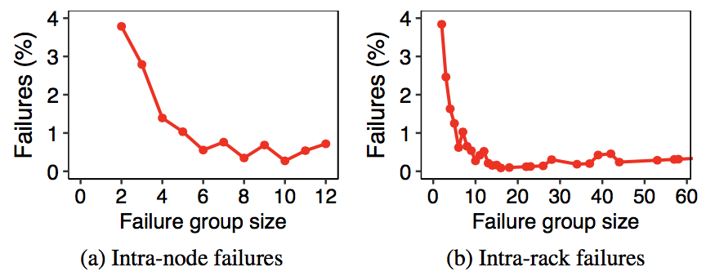
Correlations Among Failures
Finding 1: A non-negligible fraction of SSD failures belong to intra-node and intra-rack failures
12.9% (18.3%) of failures are intra-node (intra-rack) failures
Intra-node (intra-rack) failure group size can exceed the tolerable limit of some redundancy protection schemes
Notes:
We first examine the severity of correlated failures
and find that a non-negligible fraction of SSD failures
belong to intra-node and intra-rack failures.
Also, the intra-node (intra-rack) failure group size
can exceed the tolerable limit of some redundancy protection schemes.

Slide 7
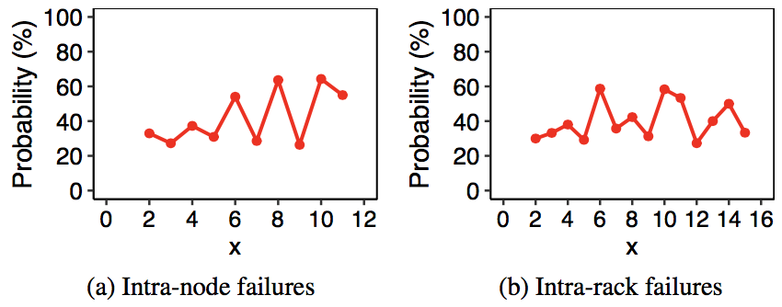
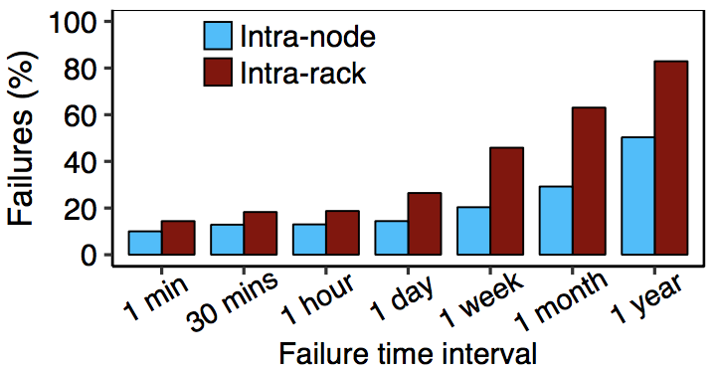
Correlations Among Failures
Finding 2: Likelihood of having an additional intra-node (intra-rack) failure depends on existing intra-node (intra-rack) failures
Finding 3: A non-negligible fraction of intra-node and intra-rack failures occur within a short period of time, even within one minute
Notes:
From the left figures, we find that the likelihood
of having an additional intra-node (intra-rack) failure
in an intra-node (intra-rack) failure group
depends on the already existing intra-node (intra-rack) failures.
We next examine how the percentages of intra-node
and intra-rack failures are affected by various thresholds
of intra-node and intra-rack failure time intervals.
We observe from the right figure that a non-negligible fraction
of intra-node and intra-rack failures occur
within a short period of time, even within one minute.

Slide 8
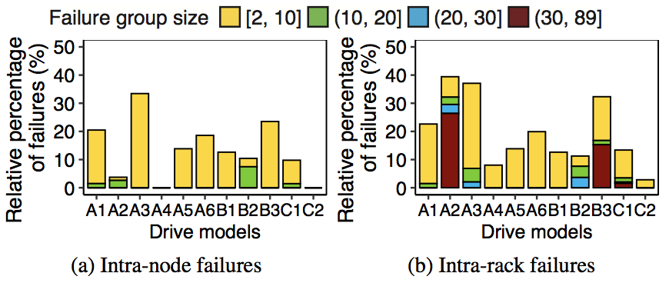
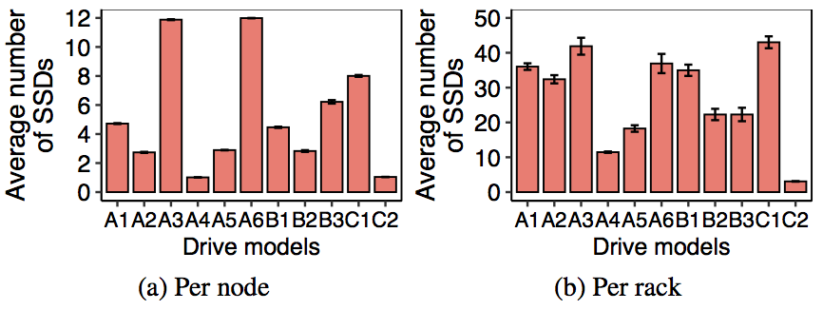
Impact of Drive Models
Finding 4: Relative percentages of intra-node (intra-rack) failures vary across drive models
Putting too many SSDs from the same drive model in the same nodes (racks) leads to a high percentage of intra-node (intra-rack) failures
AFR and environmental factors (e.g., temperature)
Notes:
We analyze the impact of drive models on correlated failures.
The left figures show that the relative percentages
of intra-node (intra-rack) failures vary across drive models.
We also examine the average number of SSDs
per node or rack for different drive models.
In general, putting too many SSDs from the same drive model
in the same nodes (racks) leads to a high percentage of intra-node (intra-rack) failures.
However, we also find that the AFR and
environmental factors (e.g., temperature) affect
the relative percentages of intra-node and intra-rack failures.

Slide 9
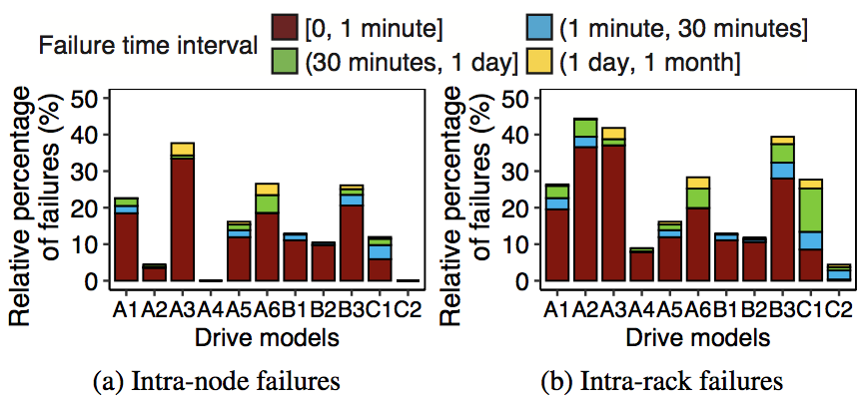
Impact of Drive Models
Finding 5: Non-negligible fractions of intra-node and intra-rack failures with a short failure time interval (e.g., one minute) for most drive models
3.5-33.4% (7.8-37.1%) of intra-node (intra-rack) failures except A4 and C2 (C2)
Notes:
We vary the thresholds of the intra-node and
intra-rack failure time interval, broken down by the drive models.
The figure shows that the intra-node and intra-rack failures
with a short failure time interval account for
non-negligible percentages for most drive models.

Slide 10
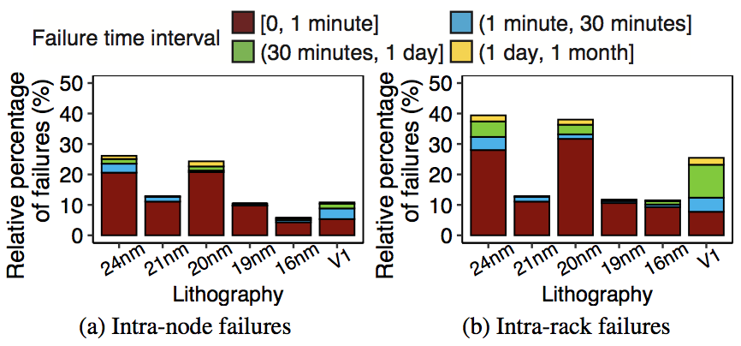
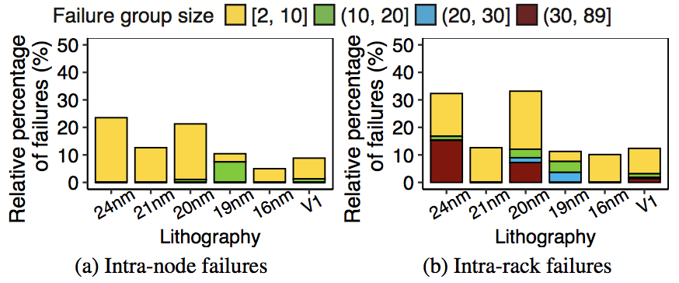
Impact of Lithography
Finding 6: MLC SSDs with higher densities generally have lower relative percentages of intra-node and intra-rack failures
For MLC SSDs, a smaller lithography implies a higher density
3D-TLC SSDs have higher densities than those of MLC SSDs
Notes:
We analyze the impact of lithography on correlated failures.
For MLC SSDs, a smaller lithography implies
that the SSDs have a higher density.
Also, 3D-TLC SSDs have higher densities than those of MLC SSDs.
From the figures, we find that MLC SSDs with
higher densities generally have lower relative percentages
of intra-node and intra-rack failures.

Slide 11
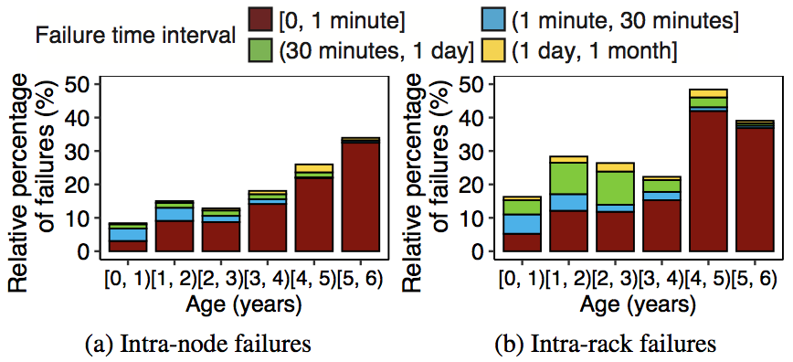
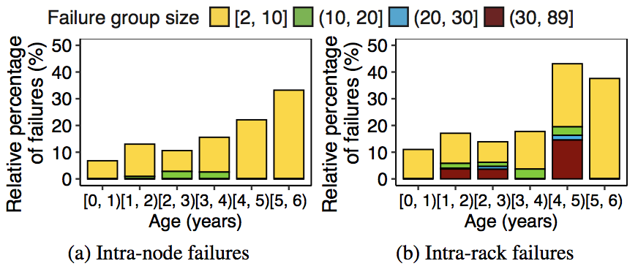
Impact of Age
Finding 7: Relative percentages of intra-node and intra-rack failures increase with age
Intra-node and intra-rack failures at an older age are more likely to occur within a short time due to the increasing rated life used
Notes:
We analyze the impact of age of a failed SSD
(e.g., power-on years until the failure occurs) on correlated failures.
We observe that the relative percentages of
intra-node and intra-rack failures increase with age.
Also, the intra-node and intra-rack failures at an older age
are more likely to occur within a short time
due to the increasing rated life used.

Slide 12
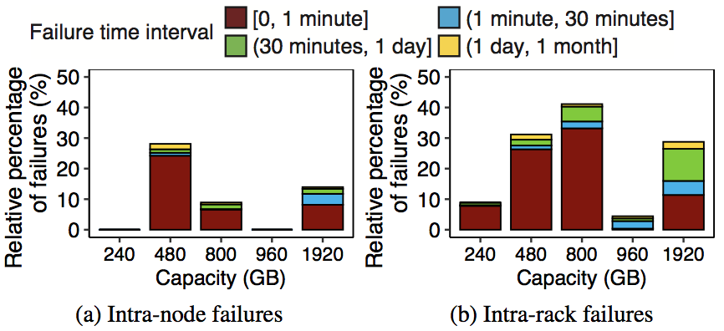
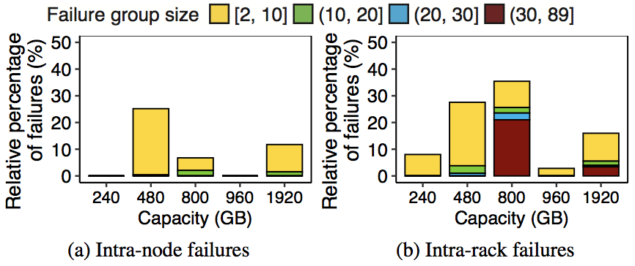
Impact of Capacity
Finding 8: Relative percentages of intra-node and intra-rack failures vary significantly across the capacity
No clear trend between relative percentages of intra-node (or intra-rack) failures for different thresholds of failure time intervals and capacity
Notes:
We analyze the impact of the capacity on correlated failures.
The left figures show that the relative percentages of
intra-node and intra-rack failures vary significantly across the capacity.
The right figures show no clear trend between
the relative percentages of intra-node (intra-rack) failures
for different thresholds of failure time intervals and the capacity.

Slide 13
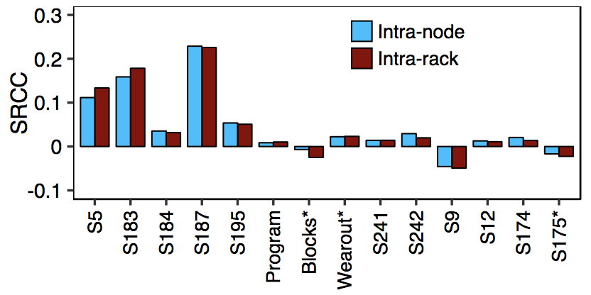
Impact of SMART Attributes
Finding 9: SMART attributes have limited correlations with intra-node and intra-rack failures
The highest SRCC values (from S187) are only 0.23 for both intra-node and intra-rack failures
SMART attributes are not good indicators for detecting the existence of intra-node and intra-rack failures
Intra-node and intra-rack failures have no significant difference of absolute values of SRCC for each SMART attribute
Notes:
We use the SRCC to examine which SMART attributes
are correlated with intra-node and intra-rack failures.
The figure shows that SMART attributes have
limited correlations with intra-node and intra-rack failures.
The highest SRCC values are only 0.23
for both intra-node and intra-rack failures.
Thus, SMART attributes are not good indicators for
detecting the existence of intra-node and intra-rack failures.
Also, intra-node and intra-rack failures have
no significant difference of absolute values of SRCC
for each SMART attribute.

Slide 14
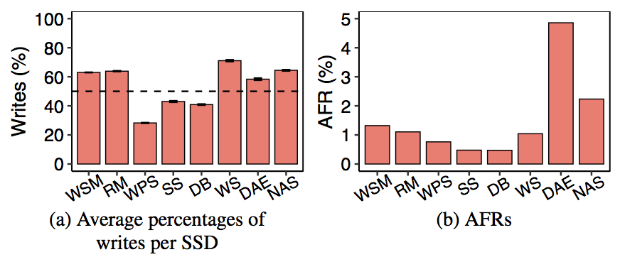
Impact of Applications
Finding 10: Write-dominant workloads lead to more SSD failures overall, but are not the only factors on AFRs
Other factors, such as drive models, can affect AFRs
Notes:
We analyze the relationships between the failure patterns
and workload distributions of the eight most widely used applications.
The figure shows that write-dominant workloads
lead to more SSD failures overall,
but are not the only factors on AFRs.
Other factors such as drive models can affect AFRs.

Slide 15
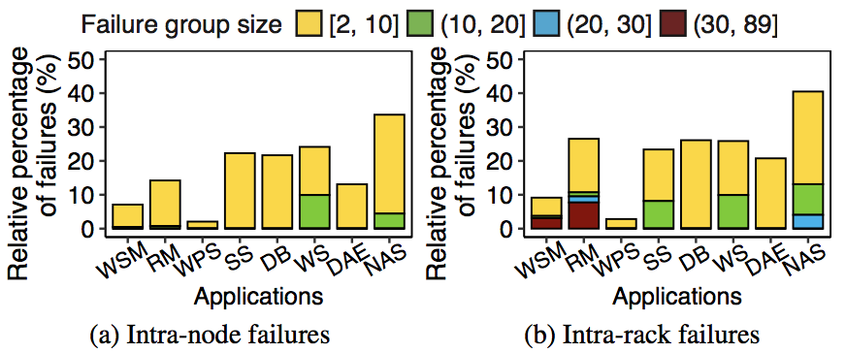
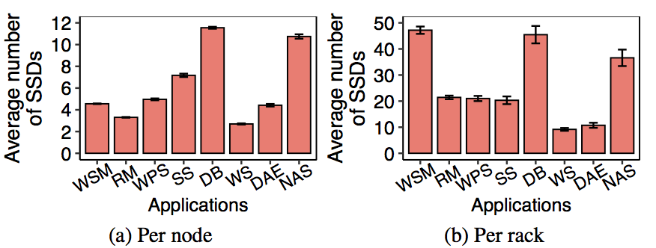
Impact of Applications
Finding 11: Applications with more SSDs per node (rack) and write-dominant workloads tend to have a high percentage of intra-node (intra-rack) failures
Notes:
We analyze the impact of applications on correlated failures.
We find that the applications with more SSDs per node (rack)
and write-dominant workloads tend to have a high
percentage of intra-node (intra-rack) failures.

Slide 16
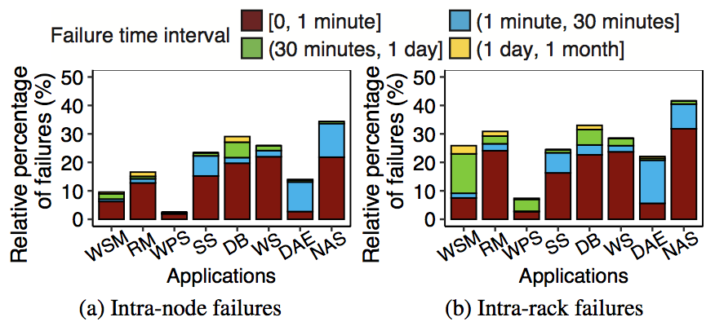
Impact of Applications
Finding 12: For the applications, intra-node and intra-rack failures at an older age and with more write-dominant workloads tend to occur in a short time
Notes:
We next vary the thresholds of the intra-node
and intra-rack failure time intervals.
The figure shows that the relative percentages of
intra-node and intra-rack failures for different thresholds
of the failure time intervals vary across the applications.
By further examining the average ages of intra-node
and intra-rack failures for the applications,
we find that intra-node and intra-rack failures at
an older age and with more write-dominant workloads
tend to occur in a short time.

Slide 17
Case Study: Redundancy Protection
Redundancy schemes
r-way replication (Rep(r)): Rep(2) and Rep(3)
Reed-Solomon coding (RS(k, m)): RS(6,3), RS(10,4), and RS(12,4)
Local Reconstruction Coding (LRC(k, l, g)): LRC(12,2,2)
Eager recovery vs. lazy recovery
Simulator
Extend C++ discrete-event simulator SimEDC[TPDS’19 Zhang]
Metrics
Probability of data loss (PDL)
Normalized magnitude of data loss (NOMDL)
Notes:
We next present a trace-driven simulation analysis
on how redundancy schemes affect the storage reliability
in the face of correlated failures in our dataset.
Our analysis consider three redundancy schemes,
r-way replication, Reed-Solomon coding, and
Local Reconstruction Coding, as well as
two recovery schemes, eager recovery and lazy recovery.
We extend SimEDC to support the reliability evaluation
on our dataset and measure the reliability with two metrics:
probability of data loss and normalized magnitude of data loss.

Slide 18
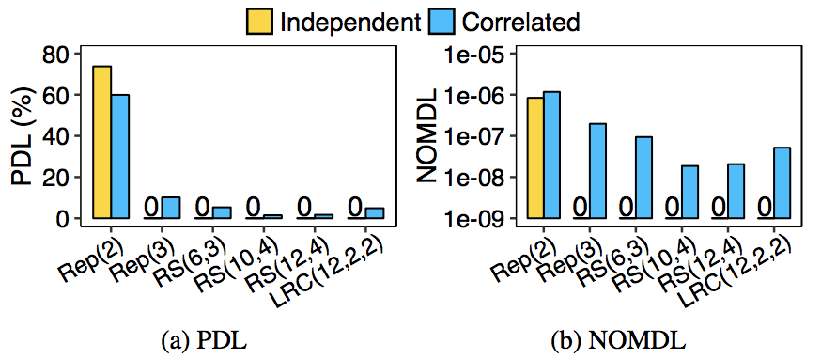
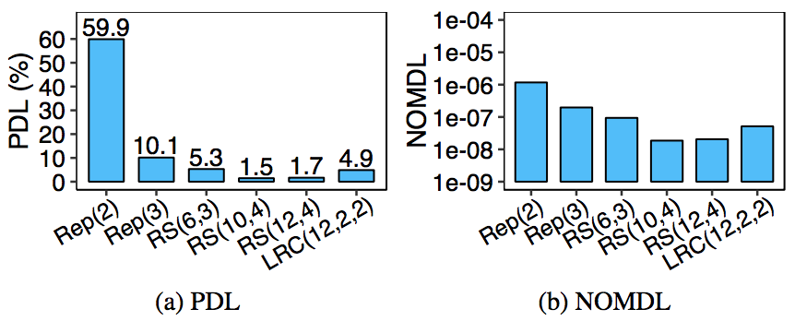
Simulation Results
Finding 13: Erasure coding shows higher reliability than replication based on failure patterns in our dataset
Finding 14: Redundancy schemes that are sufficient for tolerating independent failures may be insufficient for correlated failures
Notes:
We first evaluate the reliability of different
redundancy schemes based on the SSD
failure patterns in our dataset.
From the left figures, we observe that
erasure coding shows higher reliability than replication.
We next examine the reliability under
only independent failures from a mathematical
failure model and under the failure patterns
in our dataset (including both independent and correlated ones).
The right figures show that the redundancy schemes
that are sufficient for tolerating independent failures
may be insufficient for correlated failures.

Slide 19
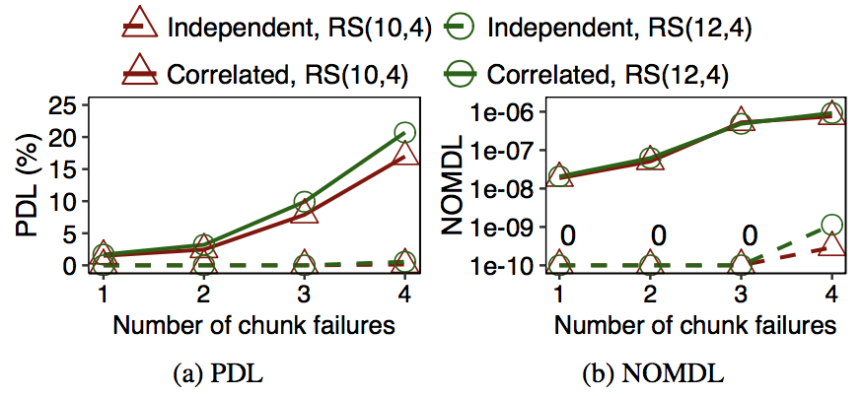
Simulation Results
Finding 15: Lazy recovery is less suitable than eager recovery for tolerating correlated failures in our dataset
Eager recovery: a threshold of one
High reliability under only independent failures
Degrading reliability under correlated failures as the threshold increases
Notes:
We finally evaluate the reliability of lazy recovery
under only independent failures from
the mathematical failure model and
under the failure patterns in our dataset.
For lazy recovery, we vary the threshold of
triggering recovery from one to four failed chunks;
a threshold of one implies eager recovery.
The figure shows that these two erasure codes
achieve a high reliability under only independent failures,
but the reliability degrades under correlated failures
as the threshold increases.
Thus, lazy recovery is less suitable than eager recovery
for tolerating correlated failures in our dataset.

Slide 20
Conclusion
We report 15 findings on correlated failures of SSDs based on large-scale dataset at Alibaba
Spatial and temporal correlations of SSD failures
Impact of different factors on correlated failures
Trace-driven simulation on reliability of various redundancy schemes under correlated failures
Dataset and source code:
https://github.com/alibaba-edu/dcbrain/tree/master/ssd_open_data
http://adslab.cse.cuhk.edu.hk/software/ssdanalysis
Notes:
To conclude, we report 15 findings on correlated
failures of SSDs based on the large-scale dataset at Alibaba.
Our analysis includes spatial and temporal
correlations of SSD failures and
the impact of different factors on correlated failures.
We also evaluate the reliability of various redundancy
schemes under correlated failures via trace-driven simulation.
Finally, we release our dataset and source code for public use.

Slide 21
Thank You! Q & A
Notes:
Thank you. I’d like to take your questions and comments.

