Slide 1
On the Speedup of Single-Disk Failure Recovery in XOR-Coded Storage Systems: Theory and Practice
Yunfeng Zhu¹, Patrick P. C. Lee², Yuchong Hu², Liping Xiang¹, Yinlong Xu¹
¹University of Science and Technology of China ²The Chinese University of Hong Kong MSST’12

Slide 2
Modern Storage Systems
Large-scale storage systems have seen deployment in practice
Cloud storage
Data centers
P2P storage
Data is distributed over a collection of disks
Disk → physical storage device
…
disks

Slide 3
How to Ensure Data Reliability?
Disks can crash or have bad data
Data reliability is achieved by keeping data redundancy across disks
Replication
Efficient computation
High storage overhead
Erasure codes (e.g., Reed-Solomon codes)
Less storage overhead than replication, with same fault tolerance
More expensive computation than replication

Slide 4
XOR-Based Erasure Codes
XOR-based erasure codes
Encoding/decoding involve XOR operations only
Low computational overhead
Different redundancy levels
2-fault tolerant: RDP, EVENODD, X-Code
3-fault tolerant: STAR
General-fault tolerant: Cauchy Reed-Solomon (CRS)

Slide 5
Example
EVENODD, where number of disks = 4
a
c
a+c
b+c
b
d
b+d
a+b+d
a?
a=c+(a+c)
b?
b=d+(b+d)
Note: “+” denotes XOR operation

Slide 6
Failure Recovery Problem
Recovering disk failures is necessary
Preserve the required redundancy level
Avoid data unavailability
Single-disk failure recovery
Single-disk failure occurs more frequently than a concurrent multi-disk failure
One objective of efficient single-disk failure recovery: minimize the amount of data being read from surviving disks

Slide 7
Related Work
Hybrid recovery
Minimize amount of data being read for double-fault tolerant XOR-based erasure codes
e.g., RDP [Xiang, ToS’11], EVENODD [Wang, Globecom’10], X-Code [Xu, Tech Report’11]
Enumeration recovery [Khan, FAST’12]
Enumerate all recovery possibilities to achieve optimal recovery for general XOR-based erasure codes
Regenerating codes [Dimakis, ToIT’10]
Disks encode data during recovery
Minimize recovery bandwidth

Slide 8
Example: Recovery in RDP
RDP with 8 disks.
Disk0
Disk1
Disk2
Disk3
Disk4
Disk5
Disk6
Disk7
⊕
d0,0
d0,1
d0,2
d0,3
d0,4
d0,5
d0,6
d0,7
⊕
⊕
d1,0
d1,1
d1,2
d1,3
d1,4
d1,5
d1,6
⊕
d1,7
d2,0
d2,1
d2,2
d2,3
d2,4
d2,5
⊕
d2,6
d2,7
⊕
d3,0
d3,1
d3,2
d3,3
d3,4
d3,5
⊕
d3,6
d3,7
⊕
d4,0
d4,1
d4,2
d4,3
d4,4
d4,5
⊕
d4,6
d4,7
⊕
d5,0
d5,1
d5,2
d5,3
d5,4
d5,5
⊕
d5,6
d5,7
⊕
Let’s say Disk0 fails.
How do we recover Disk0?

Slide 9
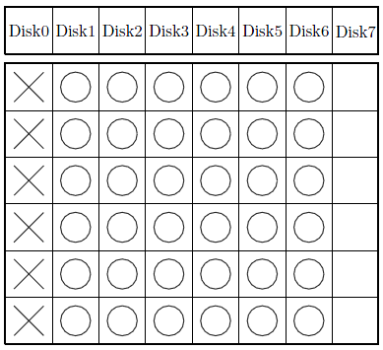
Conventional Recovery
Idea: use only row parity sets. Recover each lost data symbol independently
Total number of read symbols: 36

Slide 10
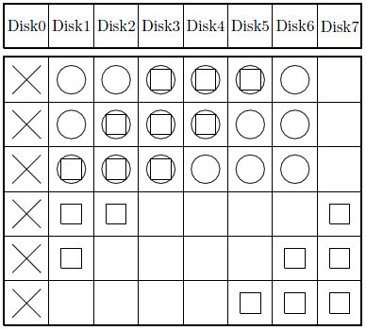
Hybrid Recovery
[Xiang, ToS’11]
Idea: use a combination of row and diagonal parity sets to maximize overlapping symbols
Total number of read symbols: 27

Slide 11
Enumeration Recovery
[Khan, FAST’12]
D0
D0
Disk0
D1
D1
D2
D0
D2
Disk1
D3
D1
D3
C0
D2
C0
Disk2
C1
D3
C1
C2
C2
Disk3
Data
C3
C3
Generator Matrix
Codeword
Total read symbols: 3
Conventional Recovery download 4 symbols (D2, D3, C0, C1) to recover D0 and D1
Recovery Equations for D0 | Recovery Equations for D1
D0 D2 C0 | D1 D3 C1
D0 D3 C2 | D1 D2 C0 C1 C2
D0 D3 C0 C1 C3 | D1 D2 C3
D0 D2 C1 C2 C3 | D1 D3 C0 C2 C3

Slide 12
Challenges
Hybrid recovery cannot be easily generalized to STAR and CRS codes, due to different data layouts
Enumeration recovery has exponential computational overhead
Can we develop an efficient scheme for efficient single-disk failure recovery?

Slide 13
Our Work
Speedup of single-disk failure recovery for XOR-based erasure codes
Speedup in three aspects:
Minimize search time for returning a recovery solution
Minimize I/Os for recovery (hence minimize recovery time)
Can be extended for parallelized recovery using multi-core technologies
Applications: when no pre-computations are available, or in online recovery

Slide 14
Our Work
Design a replace recovery algorithm
Hill-climbing approach: incrementally replace feasible recovery solutions with fewer disk reads
Implement and experiment on a networked storage testbed
Show recovery time reduction in both single-threaded and parallelized implementation

Slide 15
Key Observation
k data disks
m parity disks
Strip size: ω
…
…
…
n disks
There likely exists an optimal recovery solution, such that this solution has exactly ω parity symbols!
A strip of ω data symbols is lost

Slide 16
Simplified Recovery Model
To recover a failed disk, choose a collection of parity symbols (per stripe) such that:
The collection has ω parity symbols
The collection can correctly resolve the ω lost data symbols
Total number of data symbols encoded in the ω parity symbols is minimum → minimize disk reads

Slide 17
Replace Recovery Algorithm
Notation:
P_{i} | set of parity symbols in the ith (1≤i ≤ m) parity disk
X | collection of ω parity symbols used for recovery
Y | collection of parity symbols that are considered to be included in X
Target: reduce number of read symbols
Algorithm:
1 | Initialize X with the ω parity symbols of P₁
2 | Set Y to be the collection of parity symbols in P₂ ; Replace “some” parity symbols in X with same number of symbols in Y, such that X is valid to resolve the ω lost data symbols
3 | Replace Step 2 by resetting Y with P₃, …,P_{m}
4 | Obtain resulting X and corresponding encoding data symbols

Slide 18
Example
D0
D0
Disk0
D1
D1
D2
D0
D2
Disk1
D3
D1
D3
C0
D2
C0
Disk2
C1
D3
C1
C2
C2
Disk3
Data
C3
C3
Generator Matrix
Codeword
Step 1: Initialize X = {C0, C1}. Number of read symbols of X is 4
Step 2: Consider Y = {C2, C3}. C2 can replace C0 (X is valid). Number of read symbols equal to 3
Step 3: Replace C0 with C2. X = {C2,C1}. Note it is an optimal solution.

Slide 19
Algorithmic Extensions
Replace recovery has polynomial complexity
Extensions: increase search space, while maintaining polynomial complexity
Multiple rounds
Use different parity disks for initialization
Successive searches
After considering P_{i}, reconsider the previously considered i-2 parity symbol collections (univariate search)
Can be extended for general I/O recovery cost
Details in the paper

Slide 20
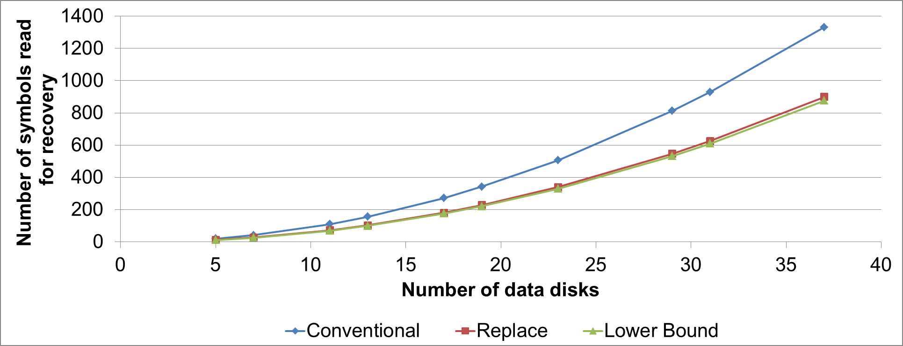
Evaluation: Recovery Performance
Recovery performance for STAR
Replace recovery is close to lower bound

Slide 21
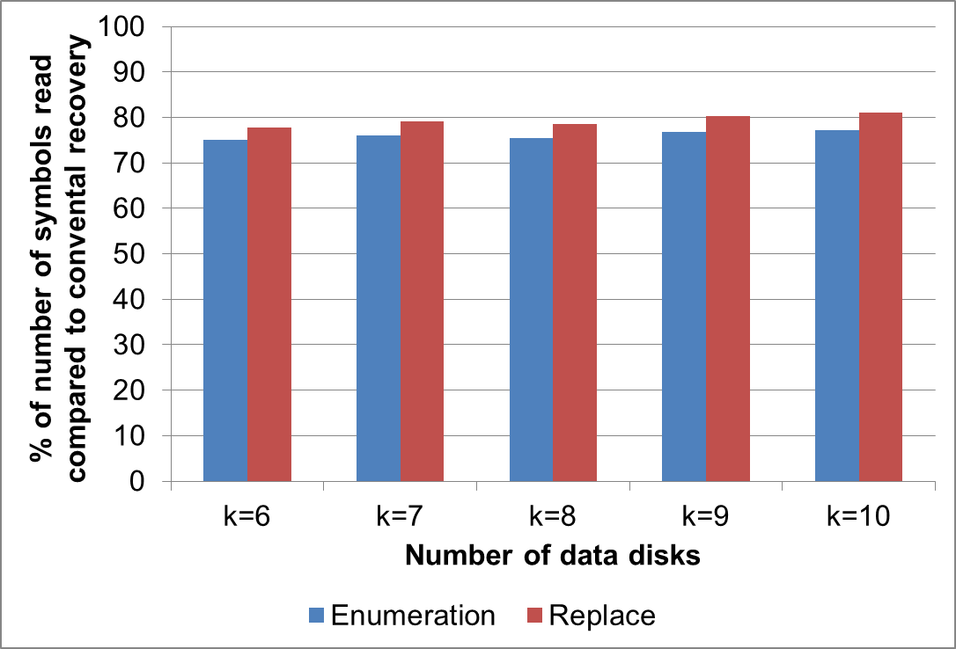
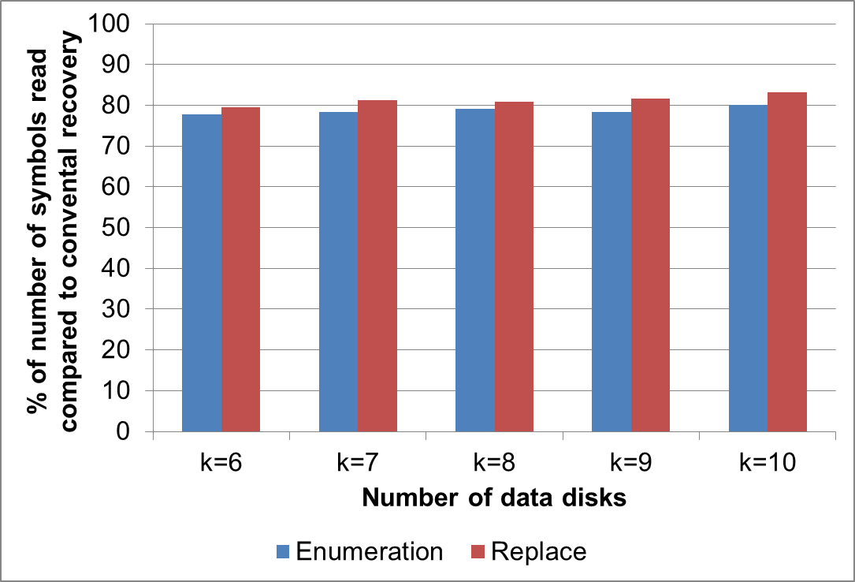
Evaluation: Recovery Performance
Recovery performance for CRS
m = 3, ω = 4
m = 3, ω = 5
Replace recovery is close to optimal (< 3.5% difference)

Slide 22
Evaluation: Search Performance
Enumeration recovery has a huge search space
Maximum number of recovery equations being enumerated is 2^{mω}.
Search performance for CRS
Intel 3.2GHz CPU, 2GB RAM
(k, m, ω) | Time (Enumeration) | Time (Replace)
(10, 3, 5) | 6m32s | 0.08s
(12, 4, 4) | 17m17s | 0.09s
(10, 3, 6) | 18h15m17s | 0.24s
(12, 4, 5) | 13d18h6m43s | 0.30s
Replace recovery uses significantly less search time than enumeration recovery

Slide 23
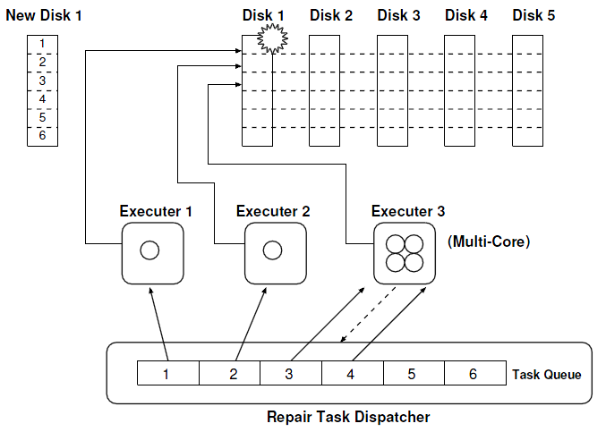
Design and Implementation
Recovery thread
Reading data from surviving disks
Reconstructing lost data of failed disk
Writing reconstructed data to a new disk
Parallel recovery architecture
Stripe-oriented recovery: each recovery thread recovers data of a stripe
Multi-thread, multi-server
Details in the paper

Slide 24
Experiments
Experiments on a networked storage testbed
Conventional vs. Recovery
Default chunk size = 512KB
Communication via ATA over Ethernet (AoE)
Types of disks (physical storage devices)
Pentium 4 PCs
Network attached storage (NAS) drives
Intel Quad-core servers
disks
Gigabit switch
Recovery architecture

Slide 25
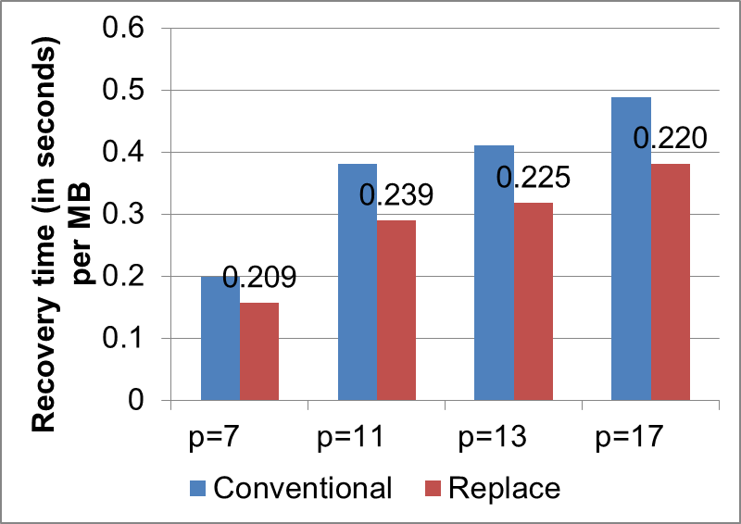
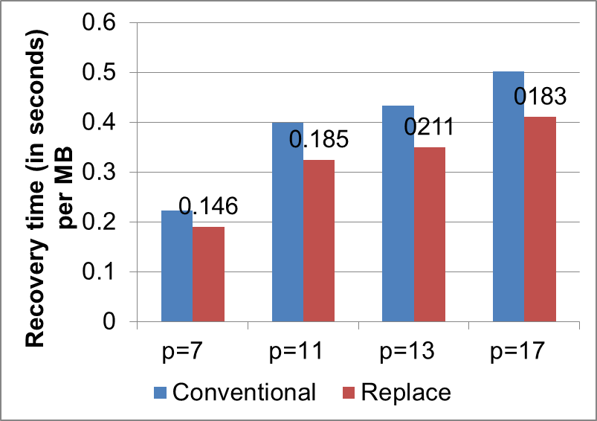
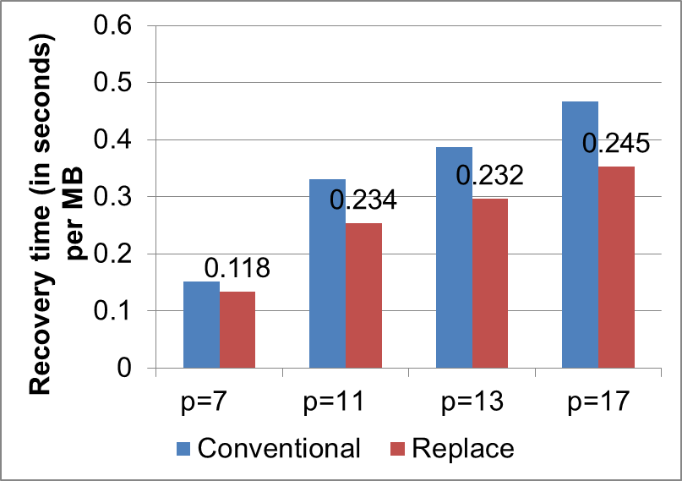
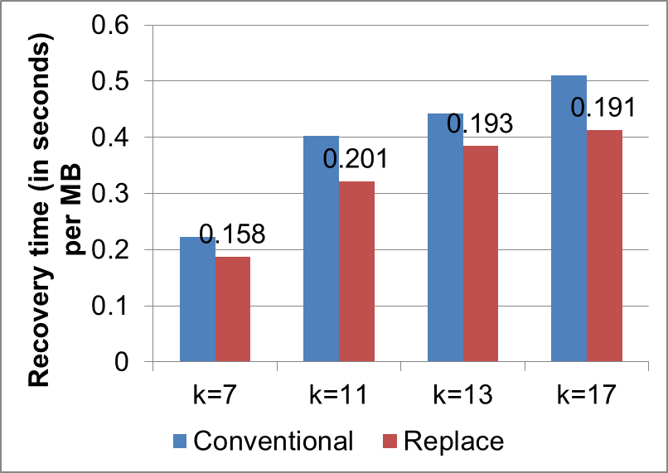
Recovery Time Performance
Conventional vs Replace: double-fault tolerant codes:
RDP
EVENODD
X-Code
CRS(k, m=2)

Slide 26
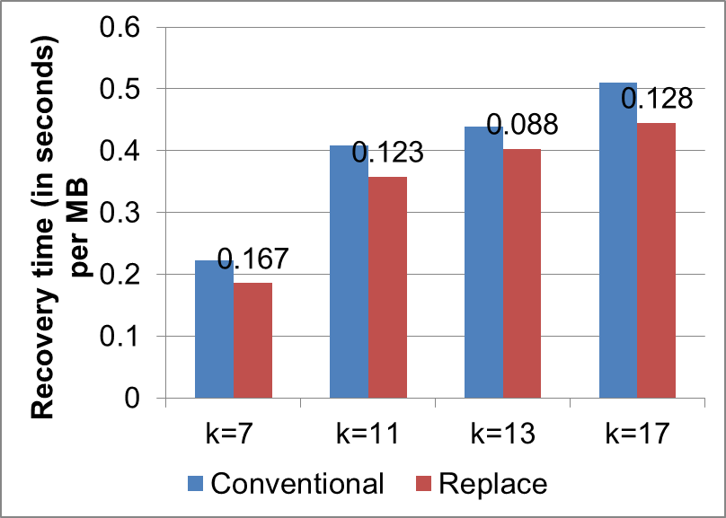
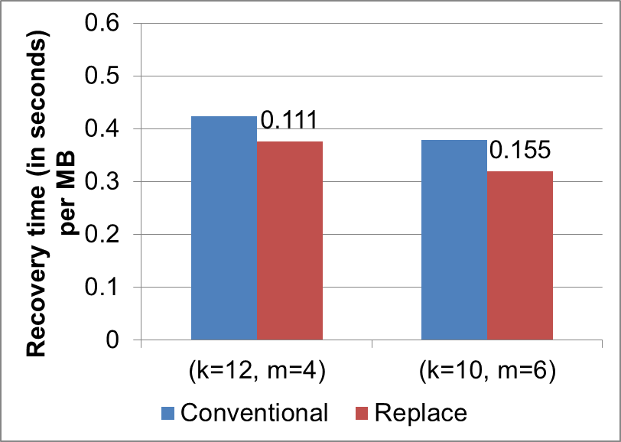
Recovery Time Performance
Conventional vs Replace: Triple and general-fault tolerant codes
STAR
CRS(k, m=3)
CRS(k, m>3)

Slide 27
Summary of Results
Replace recovery reduces recovery time of conventional recovery by 10-30%
Impact of chunk size:
Larger chunk size, recovery time decreases
Replace recovery still shows the recovery time reduction
Parallel recovery:
Overall recovery time reduces with multi-thread, multi-server implementation
Replace recovery still shows the recovery time reduction
Details in the paper

Slide 28
Conclusions
Propose a replace recovery algorithm
provides near-optimal recovery performance for STAR and CRS codes
has a polynomial computational complexity
Implement replace recovery on a parallelized architecture
Show via testbed experiments that replace recovery speeds up recovery over conventional
Source code:
http://ansrlab.cse.cuhk.edu.hk/software/zpacr/

Slide 29
Backup

Slide 30
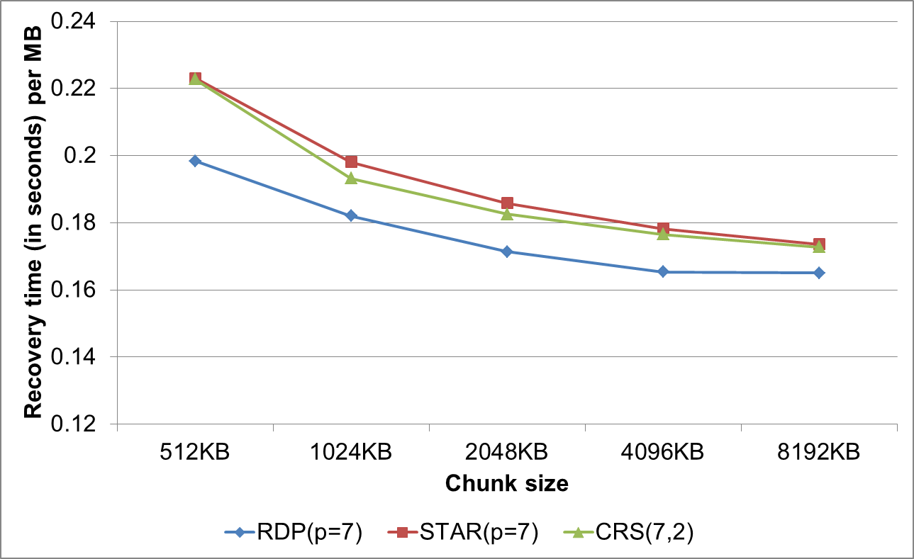
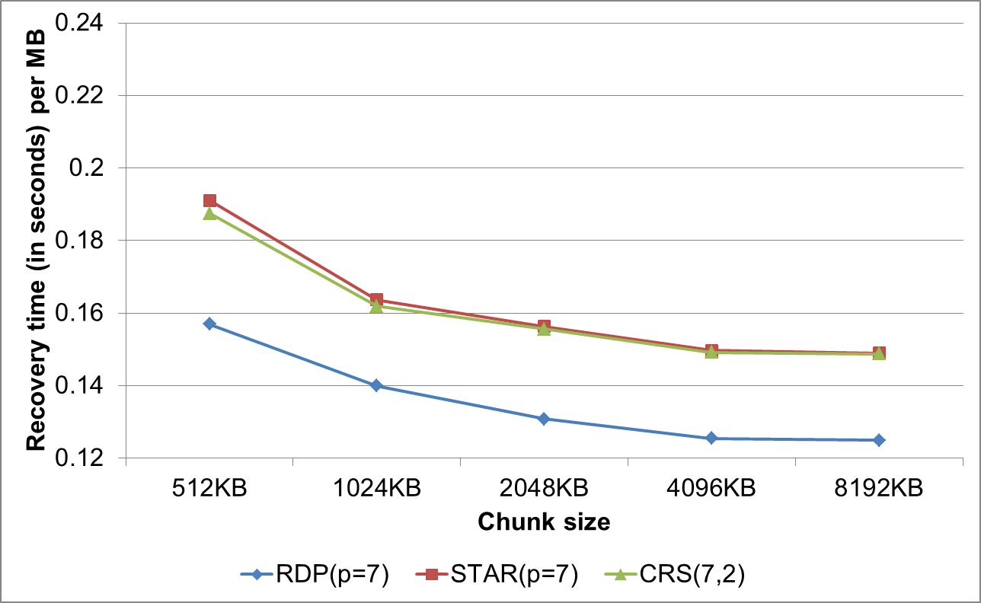
Impact of Chunk Size
Conventional recovery
Replace recovery
Recovery time decreases as chunk size increases
Recovery time stabilizes for large chunk size

Slide 31
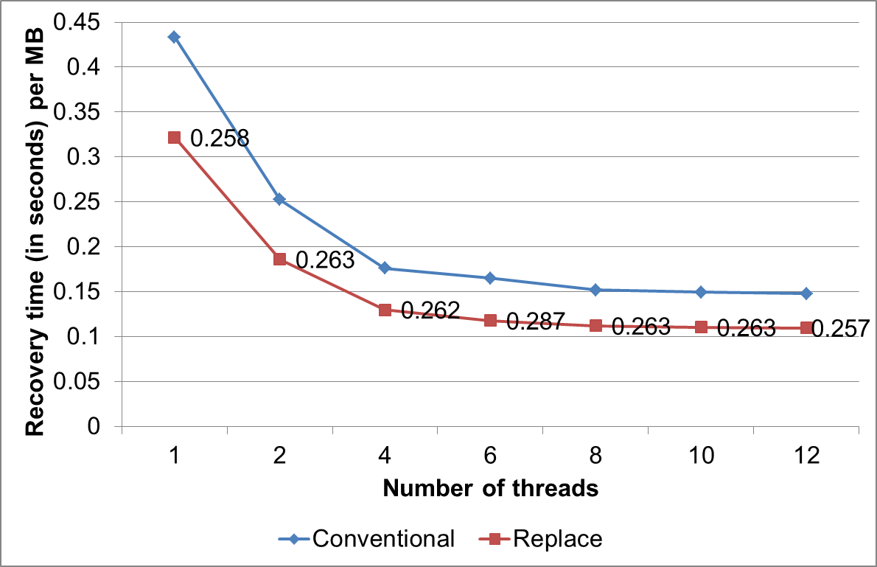
Parallel Recovery
STAR (p = 13)
Quad-core case
Recovery performance of multi-threaded implementation:
Recovery time decreases as number of threads increases
Improvement bounded by number of CPU cores
We show applicability of replace recovery in parallelized implementation
Similar results observed in our multi-server recovery implementation

